Slide 1
Growing up talk
Year 6
0-19 Public Health Team
2025
Notes:
Introduce self and your role.
Discuss the plan for the day and discuss content from list (break time depends on the school)
Give out pieces of blank paper to all the children.
Explain that at the end there will be a question box.
At anytime in the session, if the children have a question, they do not want to ask out loud they can write it down on the paper.

Slide 2







Ground Rules
Be Respectful
Private Space
It's Okay to Giggle
But be mature.
Ask Questions
Family Words used:
“Balls”
“Mini Moo”
“Fluff”
“Willy”
Use of the correct words.
Penis, Vagina, Breasts, Testicles, Scrotum
“Boobs”
“fu-fu”
Notes:
Introduce Ground Rules.
Be Respectful
Listen when others are speaking and respect everyone's questions and feelings.
We are sensitive to other peoples' feelings and do not laugh or react rudely to people’s questions.
Everyone should think carefully before contributing to discussions – is what you are about to say appropriate?
If you are not sure you can always write your question down on your paper.
It's Okay to Giggle
Some topics might seem funny, and that's normal! But try to be mature
Private Space
What we discuss stays in our classroom. Do not discuss today with the lower year groups.
They can talk to their peers in their year group but do not share with younger year groups or younger siblings.
Fine to talk to parents and older siblings when they get home but not younger siblings.
When people ask questions or share their feelings, these things stay in the classroom.
UNLESS
They share something that we are worried about, then we will talk about this with their teacher further.
Ask Questions
There are no silly questions. If you're wondering about something, others probably are too!
Encourage the children to ask questions.
Explained that they need to put their hands up, if they do not feel comfortable putting their hands up write their questions down on a piece of paper they will be given.
There will also be time to ask questions at the end.
Most questions will be answered.
All pieces of paper must be folded and handed in even if they are blank.
Most questions will be answered; however, we might feel that some questions are not appropriate, and they will not be answered.
Use of the correct words.
We will use the correct words for your body parts, this is your time to say the words you use at home for your private areas.
Using the correct words, Give the students time to speak out loud some of the words that are used in the family home.
Examples: Fu-fu, willy, ball… ect.
Give the correct words….
Reason due to if they want medical attention and you were using the family word and the person you was speaking to do not speak English then they might not understand what you are talking about, but they do know the correct language.
Anonymous:
Ask the children if they know what this word means.
Please ask the children to not share personal information from home.
If they want to talk about something, they must use someone I know rather than my brother or my mum for example.

Slide 3
Growing and Changing We will learn about today.
What is puberty? | Consent
What happens to Boys during puberty | Transitions to secondary School
What happens to Girls during Puberty and periods | Relationships
Personal Hygiene | Human reproduction from Conception to Birth of a baby
July 2020
Notes:
Discuss the list and explain this the content of today’s PowerPoint.
Explain that if anyone feels unwell during the session they must put their hand up straight away and ask for help.

Slide 4



Puberty is…
Puberty is when a child’s body begins to change into the body of an adult.
Hormones are released from the brain into the bloodstream, leading to a changes: physically, emotionally and socially
Notes:
Hormones are released from the Pituitary Gland when a child is starting puberty, around the ages of 9 to 16 years old.
Puberty is the name we give to a set of changes that happen in our bodies due to hormones that are released by brain and other glands in the body.
Puberty describes the time when we grow from children into adults.
There are around 50 different hormones that our bodies make all with different jobs, some of these control puberty.
The hormones that affect puberty cause changes to the shape and size of our bodies, which when finished have changed the body and made it able to reproduce (make a baby).
Our moods and behaviours change too during puberty.
The same hormones that cause changes in our bodies also help develop our brains.
Through puberty, our brains strengthen and develop the connections that allow for mature ways of thinking, feeling, and behaving (Kabotyanski & Somerville, 2021).
Most girls start puberty between the ages of 8 and 13 (the average age is 12), and have a growth spurt between the ages of 10 and 14.
Most boys start puberty between the ages of 10 and 13, and continue to grow until they're around 16 (Kids Health, 2019).
Once it begins, it lasts about 2 to 5 years.
But every child is different and there's a wide range of what's normal.
A child may begin puberty a little earlier or later and finish sooner or later than their peers (St Lukes 2024)
You can't do anything to make your body develop faster.
Of course, you should eat a nutritious diet, exercise, and get enough sleep.
But special diets, dietary supplements, or creams won't do anything to make normal puberty happen quicker.
If you're a girl who's 13 or older or a boy who's 15 or older and you haven't shown any signs of puberty (or if you're younger but are still worried), talk with your doctor (KidsHealth, 2015).
Further:
Talk about how puberty prepares the reproductive system and discuss why we reproduce.
How can people feel about growing up?
Who can we talk to about the changes we might experience?

Slide 5
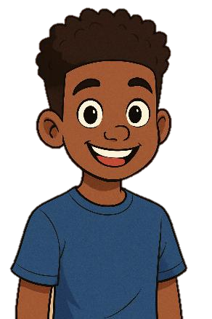

Hormones: Travel in our blood around the body.
Male Hormones
Males are born with two testicles in their scrotum.
Males start to produce Testosterone in the testicles and start to produce sperm.
The average age for males to start puberty is typically between 9 and 14 years old, with most boys beginning around age 11 or 12.
Can you name some of the other changes?
Notes:
https://chatgpt.com/s/m_687a2d2a08ec8191b7ecba81e4de67a6
Ask the class to discuss with partner some of the changes they can remember and have a show of hands to answer.
Puberty in boys usually starts with growth of the testicles and scrotum, followed by other changes like:
Growth spurts in height and weight
Voice changes and deepening
Development of body hair
Increased muscle mass
It's worth noting that there's quite a bit of normal variation - some boys may start as early as 9 or as late as 14 and still be within the typical range. Factors like genetics, nutrition, and overall health can influence timing. If there are concerns about early (before age 9) or delayed (after age 14) onset of puberty, it's worth consulting with a doctor.
Male puberty starts when hormones from the pituitary gland signal the testes to produce testosterone and sperm. Testosterone is the main male sex hormone, and it drives the development, such as a deeper voice, facial hair, increased muscle and bone growth, and the penis and testicles develop.

Slide 6

Puberty for Boys
Notes:
Busy bodies: What happens to boys (2020) HSE , Sexual health and crisis pregnancy programme [Accessed 25/07/2023] Available online: 3. What happens to boys? on Vimeo

Slide 7
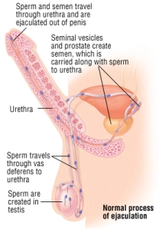

An erection is where the penis fills with blood, becomes hard and stands away from the body.
Erections can happen randomly, when the penis is touch or when you have thoughts of a sexual nature
What is an erection?
What is happening?
Erections can lead to ejaculation
Notes:
Talk through the image
Erections-
When a male is sexually excited, or sometimes for no reason at all his penis becomes harder and stands away from the body.
The penis goes hard because it fills with blood. This is an erection.
You can get an erection if your penis is touched or rubbed; if you have exciting or happy thoughts, if you see someone who you are attracted too- there are lots of causes.
You can get an erection for no reason at all, even sometimes when you don’t want to have one, which might take you by surprise.
Don’t worry if you think everyone will know when you’ve got an erection they are not as noticeable as you think and will soon go away.
Don’t worry it’s the same for all boys.
It can be helpful to talk to someone you know that is older than you, your Dad, older brother or a male grown up you can trust if you have any questions or anxieties.
You can also talk to your Mum or a female adult too.
Erections will go away either on their own after some time passes or if the male ejaculates.
Ejaculation:
Males of all ages can get erections, from babies to old men.
The difference is that only after puberty do males produce sperm and semen, which sometimes comes out of the penis when it is erect.
Boys are unlike girls who are born with their female sex cells (eggs).
Boys make their make sex cells which are the sperm when they go through puberty.
Sperm is microscopic and looks like tadpoles.
When a male ejaculates, the sperm which is in the liquid semen leaves the penis through the urethra (where you wee from).
The body must keep the sperm at the right temperature, so you may find that your testicles can either be tight to your body when it is cold or hang lower down when it is hot.
It is common for your testicles to not always look even (Kids Health, 2022).

Slide 8
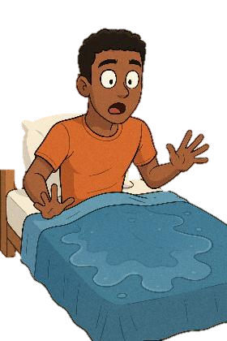
Puberty for Boys
What is a wet dream
What does it mean??
Notes:
Talk through the image
Swimming boy by Maria Keller on Dribbble
. Image: UGH I HAD A WET DREAM | Puberty problem (wordpress.com)
Wet dreams-
Sometimes you can ejaculate when you are asleep. This is called a wet dream.
Wet dreams begin during puberty when the body starts making more testosterone, a male hormone.
It happens without you knowing about it- you may notice that your PJ’s, boxer shorts or sheets feel a bit wet or sticky when you wake up.
This substance/liquid this is called semen and contains sperm cells which are the male sex cells.
This is nothing to worry about- all boys have wet dreams sometimes.
What is important is that you make sure that you put your sheets and your underwear/pyjamas or clothes that have semen on them.
Image: UGH I HAD A WET DREAM | Puberty problem (wordpress.com)

Slide 9
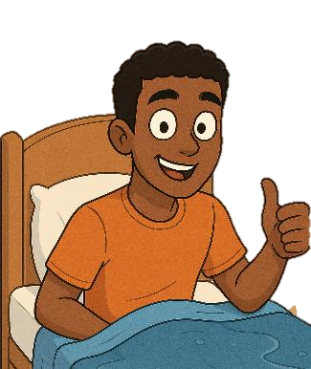

A wet dream is when a male ejaculates during sleep.
Puberty hormones cause natural physical responses during deep sleep
You may wake up and notice a small wet/sticky patch.
You cannot control wet dreams; most males, but not all, have them, and they happen less in adulthood.
What to do:
Maintain good hygiene
Change bedding/clothing as needed
Remember: This is a natural part of growing up, just like other changes that happen during puberty.
Notes:
Wet dreams-
Sometimes you can ejaculate when you are asleep. This is called a wet dream.
Wet dreams begin during puberty when the body starts making more testosterone, a male hormone.
It happens without you knowing about it- you may notice that your PJ’s, boxer shorts or sheets feel a bit wet or sticky when you wake up.
This substance/liquid this is called semen and contains sperm cells which are the male sex cells.
This is nothing to worry about- all boys have wet dreams sometimes.
What is important is that you make sure that you put your sheets and your underwear/pyjamas or clothes that have semen on them.
Image: UGH I HAD A WET DREAM | Puberty problem (wordpress.com)

Slide 10

Hormones: Travel in our blood around the body.
Female are born with eggs in their ovaries, The hormone oestrogen prepares the body to start releasing eggs, resulting in monthly periods.
Breast buds will start to develop
The average age for girls to start puberty is typically between 8 and 13 years old, with most girls beginning around age 10 or 11 - which is generally about a year earlier than boys on average.
Can you name some of the changes?
Notes:
Female puberty starts when hormones from the brain trigger the ovaries to produce oestrogen, signaling the beginning of physical changes like breast development, followed by pubic hair growth, a growth spurt, and eventually menstruation.
This process is initiated by the pituitary gland, which releases FSH and LH, hormones that stimulate the ovaries to make estrogen and release eggs.
Puberty in girls usually starts with breast development (breast budding), followed by other changes like:
Growth spurts in height and weight
Development of body hair
Hip widening and body shape changes
Onset of menstruation (menarche), which typically occurs about 2-3 years after breast development begins
The average age for first Period is around 12-13 years old, though this can range from about 10 to 16 years old and still be considered normal.

Slide 11


Puberty for Girls
Notes:
(Busy bodies, 2020)

Slide 12
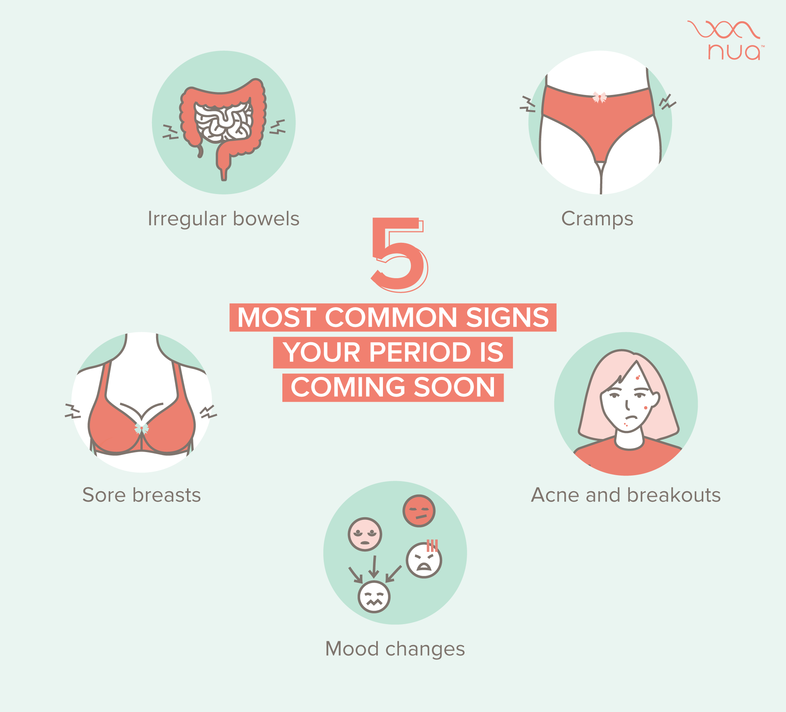
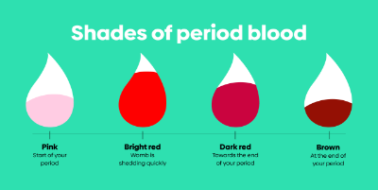
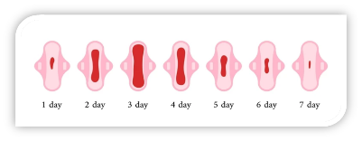
Period Symptoms
1: What are the 5 main symptoms that your period might be starting?
2: What colour can period blood be?
3: How long does a period usually last?
Notes:
5 common symptoms your period is going to start:
Period cramps
Mood changes
Spots on your face
Breasts can feel tender or slightly larger.
Upset tummy.
Discuss the normal colours of period blood.
This could be pink, bright red, dark red and brown.
The colour changes as you progress through your period.
Usually at the start of the period you have a lighter colour, maybe pink.
The colour gets darker until the end when it is usually a brown colour.
Discuss the flow of period blood, how it starts of slowly, gets heavier towards the middle of the period and then slows down until it stops.
How long will my first period last?
Your first period might not last very long, as it can take your body some months to get into a regular pattern.
As a rule, once they're settled, you'll have a period every 23 to 35 days and it will last 2 to 7 days (NHS Conditions, 2023).

Slide 13
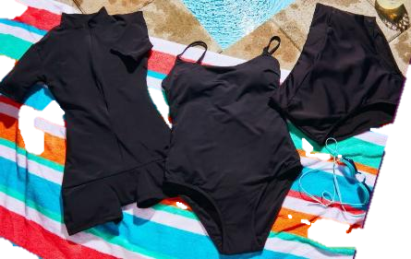
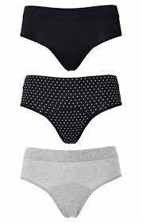
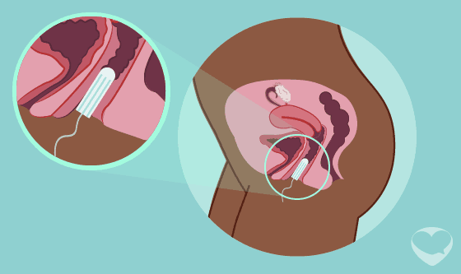

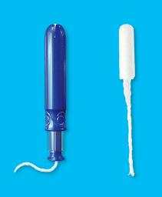
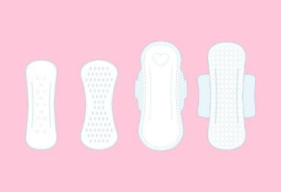

Period Products
Notes:
Pads and tampons - LoveMatters Africa https://lovemattersafrica.com/our-bodies/female-body/pads-and-tampons/

Slide 14
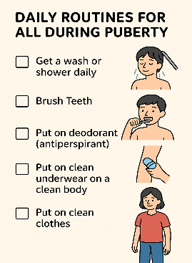


Why is Personal Hygiene Important?
1: It becomes your responsibility to keep yourself clean.
2: Your skin changes, sweat glands develop, and you produce more sweat
(You become smellier!)
3: Remembering to clean/wash your 3 hot spots.
Personal hygiene becomes more important to you during puberty for three reasons:
Here is a routine we could follow:
Notes:
Ask the class what is personal hygiene?
Personal Hygiene is how we look after our bodies.
Keeping ourselves clean and tidy makes us feel better about ourselves, helps to keep us healthy and to support the health of those around us.
Give the class 5 minutes to discuss in small groups what things they need to do as part of their personal hygiene and how often, ask them to share their ideas by putting their hands up; Reveal the answers and discuss how to and when.
Our teeth can wear out faster than many parts of our bodies. To look after our teeth we should:
brush our teeth twice a day, for at least two minutes
use a fluoride toothpaste every time we brush
eat less sugary and sticky foods
visit the dentist every six months
In puberty, some young people find they need to wash their hair more often. At this age, you will start to realise that people’s hair is different; some people have greasier hair than others.
The body odour smells that are caused by stale sweat, can also hang around on our clothes. Some clothes should be changed every day, like socks and underwear.
They come into contact with the sweatiest bits of our bodies, so change these daily.
PE kit and sports gear should also be washed often.
Shirts, trousers and dresses don’t usually need to be washed every day they’re used but should be aired overnight before being worn the next day.
Washing hands, especially after you’ve been to the loo or before eating, is especially important.
Doing these reduces the likelihood of you becoming ill.
Regular handwashing in warm, soapy water also helps to prevent you from spreading infections to other people or contaminating food.
Personal hygiene becomes more important during puberty for two reasons.
You are at an age when washing and cleaning yourself is your responsibility.
When you were younger, a parent or carer would have helped you with brushing teeth, bathing and remembering to put your clothes out to be washed.
Once you’re at the end of primary school, you’re probably doing most of these things for yourself. This is called independence.
The second reason why keeping clean becomes more important is that our skin starts to change during puberty.
Both boys’ and girls’ bodies change during puberty, but one of the main changes that we all experience is that our sweat glands grow and start to produce more sweat.
Shower or bathe regularly and if you can’t, be sure to wash areas that often get sweaty, such as underarms and between the legs.
You may also find it useful to wear deodorant too. Soaps help to remove grease and dirt from the skin and from surfaces (Twinkl, 2023).

Slide 15

Questions | Answers
Where are the three hot spots you sweat most in during puberty?
When does puberty usually begin? (a) 9 to 16 yrs (b) 6 to 9 yrs (c) 17 to 21 yrs
Why do breasts develop?
What happens to a female once a month?
What do the testicles start to produce during puberty?
How long does puberty last?
What types of products can a female use during a period?
Are wet dreams normal?
What is a mood swing?
Should I be worried about puberty?
Armpits, Private Area, Feet
A. 9 to 16 years old
To produce milk to be able to breastfeed a baby
A period (Menstruation)
Sperm / Semen
Puberty last 2 to 5 years
Tampons, Pads, Period pants
Yes, it’s your body producing testosterone
Your emotions are changing due to the hormones
No, it is all natural and part of growing up
Notes:
Armpits, feet and pubic area
It starts around age 9 years old or can start as late as 16 years old and can last for a few years.
In people with a vulva, the hormone oestrogen stimulates milk glands in breasts to grow. Milk glands are cushioned by fatty tissue for protection. It takes about 3-5 years to fully develop. These hormones can cause some swelling and tenderness in the breast area.
Period or menstrual cycle
Sperm / seaman
No everyone changes during puberty at different times and different speeds, if puberty does not happen for you then you by the age of 16 year (year 11) then speak to a trusted adult who can access the GP for you to speak about this further.

Slide 16
Let’s Talk about Consent?
What is Consent?
Dictionary definition:
Permission for something to happen or agreement to do something.
Let’s ask everyone?
YES doesn’t mean “Yes” every time
It’s ok to say “NO”
Notes:
consent means understanding that everyone has a choice and the right to say "yes" or "no" to something that involves them, such as physical touch, their belongings, or their personal space. It's about asking for permission and respecting the answer, even if it's a "no". Children should also learn they can change their minds after giving consent and that they have the right to set boundaries and say "no" to things that make them uncomfortable
The legal age of consent in the UK to have a sexual relationship is 16 years old
(that is when you will be in year 11 or when you leave school)
Any sexual acts under that age is illegal.

Slide 17



Do you know what the legal age of consent to sexual activities in the UK is…

Slide 18
How Relationships Can Change During Puberty.
More independence
What might change in your relationships with friends and family when going through puberty.
Emotions will become more uncontrollable, and you might start falling out with friends more.
Spending more time with friends rather than family
Start to want more privacy
You start to become led more towards “friends” behaviours and actions.

Slide 19

Sexual Reproduction / Making a baby
Sexual reproduction is when a male sex cell (sperm)
and female sex cell (egg) join and grow into a baby.
The egg and sperm meet during sexual intercourse.
Notes:
5 How are babies made? – YouTube https://www.youtube.com/watch?v=QekcR7JI4Po&list=PLltgannkj2UG1oLFaDGQsaCfUboF17aH2&index=5
Discuss before showing the image of intercourse how sexual reproduction works.
Bring up the image of sexual intercourse and explain what they are looking at.
This slide shows a cross section of sexual intercourse for the purpose of reproduction.
Explain that the male's penis will become erect like we talked about previously.
The male will put the erect penis into the female's vagina
The male will ejaculate, and sperm will travel from the testes through the sperm duct and into the vagina.
The sperm will then travel up the vagina and into the uterus in the search for the egg.
Sperm can survive inside the female for up to five days.
If egg is ready and has been released by the ovary, and the sperm and egg meet, the sperm may fertilise the egg, and begin growing into a baby.
Only one sperm can fertilise the egg.
Once the sperm has got inside the egg (fertilized) it is known as a zygote. The cells divide and start to grow.

Slide 20
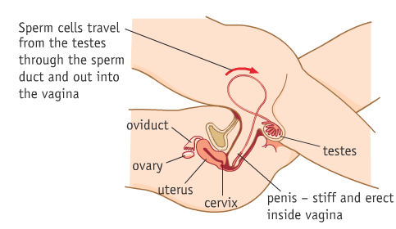
Sexual Reproduction &
Making a baby
Notes:
5 How are babies made? – YouTube https://www.youtube.com/watch?v=QekcR7JI4Po&list=PLltgannkj2UG1oLFaDGQsaCfUboF17aH2&index=5
Discuss before showing the image of intercourse how sexual reproduction works.
Bring up the image of sexual intercourse and explain what they are looking at.
This slide shows a cross section of sexual intercourse for the purpose of reproduction.
Explain that the males penis will become erect like we talked about previously.
The male will put the erect penis into the females vagina
The male will ejaculate, and sperm will travel from the testes through the sperm duct and into the vagina.
The sperm will then travel up the vagina and into the uterus in the search for the egg.
Sperm can survive inside the female for up to five days.
If egg is ready and has been released by the ovary, and the sperm and egg meet, the sperm may fertilise the egg, and begin growing into a baby.
Only one sperm can fertilise the egg.
Once the sperm has got inside the egg (fertilized) it is known as a zygote. The cells divide and start to grow.

Slide 21
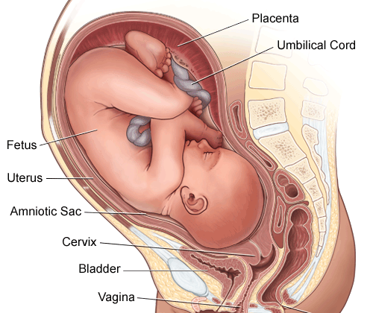
How a baby is made, grows and is born.
.
Notes:
Talk through the video explaining to the children what is happening as they watch it.
Explain the video initially shows an ejaculation, the sperm travels to meet the egg.
A sperm fertilises the egg, and a baby begins to grow.
Discuss the baby growing and the stages you can see.
Talk afterwards about the birth, how babies are born.
They ways which babies can be born, vaginal delivery and c-section.
The umbilical cord, what it is for.
How long a baby is in the womb for (womb is another term for uterus).
Use this time to let the students ask questions.
Ask the class if they know of anyone in their family who are expecting a baby.
What word do we use to describe a women who is expecting a baby?
Ask if they know how a baby inside mum’s tummy gets its nourishment?
Ask if they know how a baby is born? Hand out How is a baby born?
Show clip

Slide 22
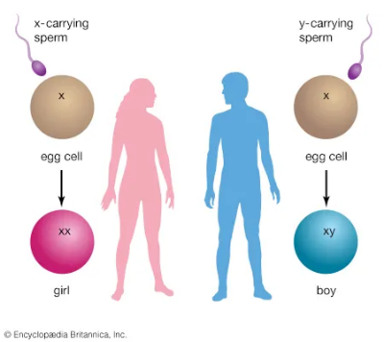
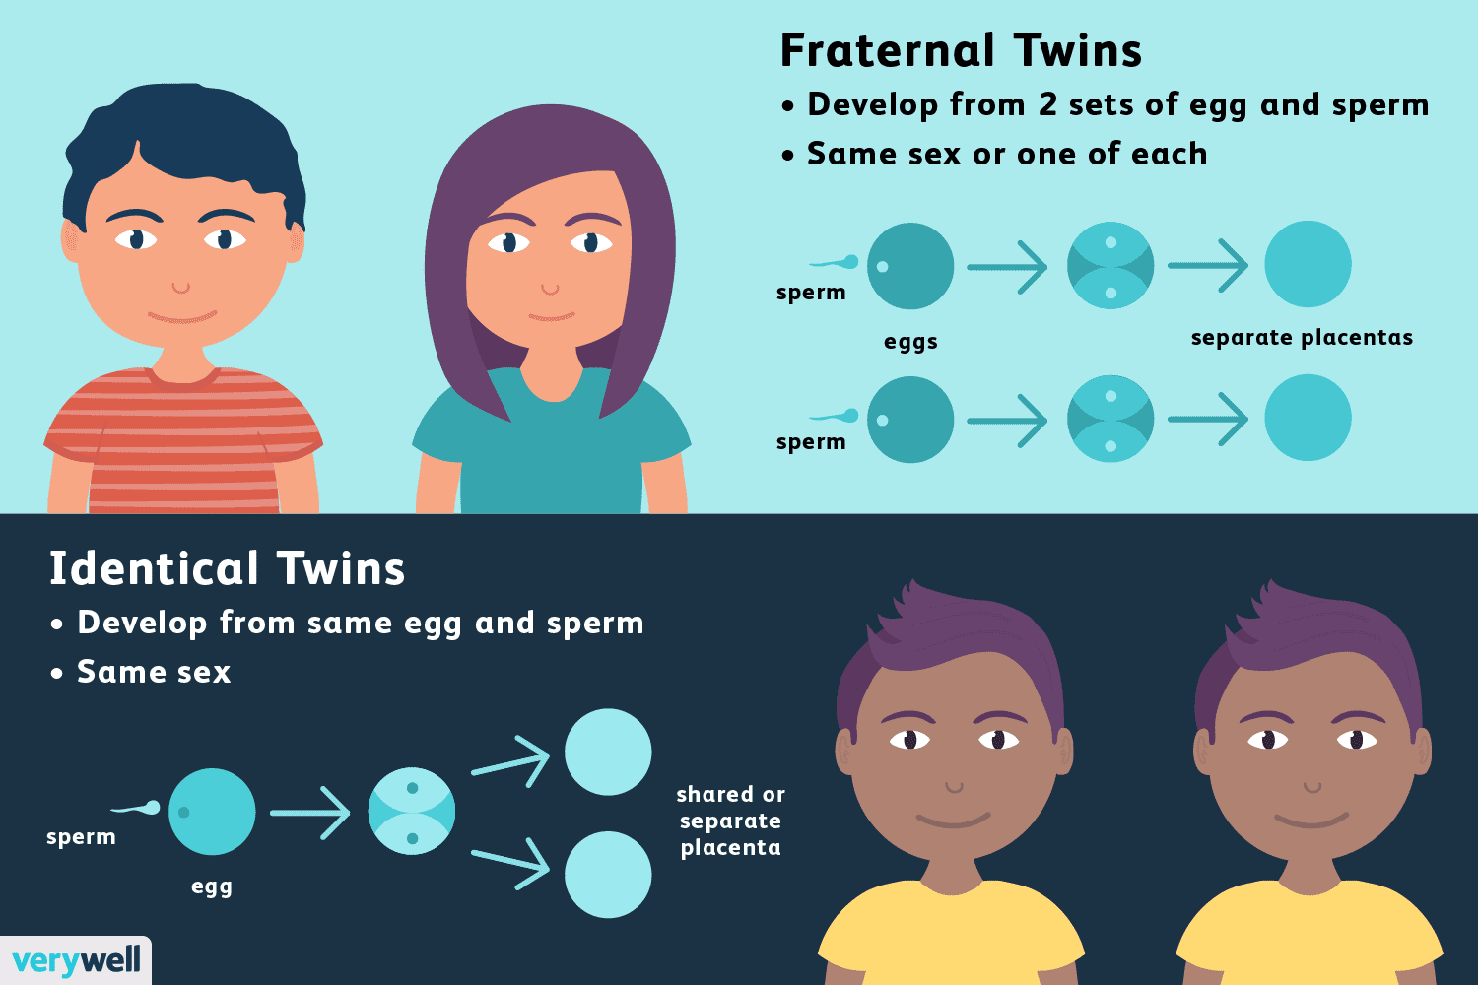
Twins
What controls if the baby is going to be a boy or a girl?
There are two types of twins.
Can you name them?
Notes:
Ask the class does any of them know how a boy is made and how a girl is made?
Explain that there are two types of sperms, some with x chromosomes and some with y.
All eggs are x.
Use the demonstration cards to explain that if a y sperm fertilizes an egg it will be a boy (xy)
If an x sperm fertilizes an egg it will be a girl (xx)
Ask the class if any of them know what type of twins there can be?
Fraternal twins
All pregnancies start when a sperm fertilises an egg.
Sometimes a woman’s ovaries release 2 eggs in the same menstrual cyle, and a separate sperm fertilises each egg.
This forms twins.
These twins are called fraternal twins, dizygotic twins (meaning two zygotes) or non-identical twins.
During pregnancy, the developing babies get oxygen and food from their mother through the placentas and umbilical cords.
Fraternal twins have separate placentas and umbilical cords.
Fraternal twins can be the same or opposite sex and their genes are as different as any other brother and sister.
Often, same-sex fraternal twins look different.
Identical twins
Sometimes a fertilised egg splits within a few days of conception to produce genetically identical twins.
Because these twins come from one zygote.
Identical twins are the same sex and identical.
There are 3 types of identical twins.
About one-third of identical twins split soon after fertilisation and form completely separate twins.
Like fraternal twins, these twins have separate placentas.
The other two-thirds split after they attach to the wall of the womb.
As a result, they share a placenta.
In a very small number of identical twins, splitting might happen even later.
In this case, both twins share an inner sac, in addition to sharing a placenta (Raising Children, 2022)
The likelihood of having identical twins is about 1 in 250 (about 0.5%).
1 in every 60 births in the UK are twins, triplets or more.
A woman is more likely to carry multiple babies if:
they got pregnant using IVF (if you had more than 1 embryo transferred into your womb)
they are over the age of 35, when you’re more likely to release more than 1 egg during ovulation
they have a family history of non-identical twins.
Identical twins usually do not run in families
X chromosome: gender determination - Kids | Britannica Kids | Homework Help

Slide 23


Sex & how babies are made quiz:
1 | You need both a man and woman to make a baby.
2 | A baby is made when a man and a woman drink strawberry milkshake together.
3 | A baby can start to grow when a sperm from a man and an egg from a woman join together.
4 | Sperm look like tiny octopus.
5 | The sperm need to get inside a woman to make a baby.
6 | The sperm go inside a woman when a man and woman have sex.
7 | A man and a woman only every have sex when they want to make a baby.
8 | Sexual intercourse is when a man puts his penis inside a woman’s vagina
9 | A man’s penis sometimes call a ‘willy’ but different families call body parts different things.
10 | During sex sperm comes out of a man's ears.
11 | Sperm are the size of apples.
12 | A woman gets pregnant every time she has sex.
13 | A baby grows for just two weeks inside the mother’s womb and then it is ready to be born.
14 | When a baby is ready to be born is shouts ‘I’m ready’ and pops out the woman’s vagina.
15 | Some adults are shy when it comes to talking about sex.
TRUE
FALSE
TRUE
FALSE
TRUE
TRUE
FALSE
TRUE
TRUE
FALSE
FALSE
FALSE
FALSE
FALSE
TRUE
Notes:
Complete with children question by question.
Make it interactive, when discussing the right answers talk more in depth about it.
For example sperm looks tadpoles.
A baby grows for 9 months inside the mothers womb.

Slide 24
Commonly asked questions:
Not every girl has period pains. It is hard to say what you will be like when yours start. Can you remember what you can do to ease period pains?
Puberty happens for most people, usually, puberty starts between the ages of 8 and 14 for girls, and between 9 and 15 for guys. If you haven’t seen ANY changes by 14 for boys, and 13 for girls you can speak to your GP.
Males can start puberty between 9 and 14 years old, with most boys beginning around age 11 or 12.
Males will start to produce sperm and will continue to do so all their lives
1: Will my period hurt?
2: What if puberty does not happen for me?
3: How long do males produce sperm for?
Once a female starts having periods, these will continue once per month until they get into their late 40s or early 50s, when they will start Menopause. This is when the body stops releasing eggs and can’t get pregnant, and periods will stop.
No, but they can take some time getting used to putting in and taking out. When inserted properly, it should not cause any discomfort. If it does hurt or is uncomfortable, you can always use a pad and try using a tampon another time. The packets have detailed instructions of how to insert them.
4: How long do females have periods for?
5: Does it hurt using a tampon?
Notes:
1: Will my period hurt?
Not every girl has period pains.
It is hard to say what you will be like when yours start.
Pain during periods is common.
It's usually caused by the womb contracting to push out the blood, not the blood passing through the vagina.
Exercise may help relieve the pain, as well as taking pain relief that you can ask your parents or carers for (NHS, 2023).
2) What if puberty doesn’t happen for me.
Usually, puberty starts between the ages of 8 and 14 for girls, and between 9 and 15 for guys.
Delayed puberty is when:
boys have no signs of testicular development by 14 years of age
girls have not started to develop breasts by 13 years of age, or they have developed breasts but their periods have not started by 15
If you have not started puberty by these ages please go and see your doctor (NHS, 2023).
3) Should I be worried about the size/shape of my penis?
No two penises are exactly alike.
Thick or thin, long or short, straight or with a little curve — everyone's got is different
So, unless it hurts or feels uncomfortable, it's safe to say your penis is totally normal (Planned Parenthood, 2024).
4) Do you have to have erections?
You cannot stop your body having erections.
Because erections usually aren't controllable, there's not much you can do to avoid getting them.
Because each person is different, it's impossible to say what's a "normal" number of erections.
Some boys experience many erections each day, whereas others may not (Teens Health, 2017).
5) Does it hurt using a tampon?
Usually, inserting a tampon doesn't hurt.
The vagina is also the birth canal, so if it can stretch to fit a whole baby, it can fit a tampon!
For some girls, though, the hymen (a little piece of tissue across the vagina) makes it harder to put in a tampon.
So, if the tampon does hurt, stop and do not force it in. You can use a pad instead.
If you're using tampons for the first time, try a slim-fit one.
Your menstrual flow should make it easier to insert because it moistens the vagina and helps the tampon slip into place (Kids Health, 2023).

Slide 25
Changes are coming:
One of the changes that happens when we grow up is moving from primary school to secondary school
It is normal to feel different emotions when changes happen.

Slide 26




Moving to Secondary School
Every secondary school in The EastRiding has a school nurse pop in once a week.
Ask during your transition week how and when you can see your school nurse if you needed to

Slide 27

How to contact school nurses
0-19 Public Health Team
01482 689689
USEFUL CONTACTS:

Slide 28
References:
Body Talk (2023) Feelings change. Available online: Feelings change | Body Talk/ [Accessed 15/12/2023].
Bodyform (2024) Brain and emotions image. Available online: Teenage brain: dealing with emotional changes during puberty | Bodyform/ [Accessed 03/01/2024].
Busy bodies (2020) What happens to girls. Available online: 4. What happens to girls on Vimeo/ [Accessed 25/07/2023].
Conran, K. M. (2020) What can I do about acne. Available online: What Can I Do About Acne? (for Teens) - Nemours KidsHealth/ [Accessed 02/01/2024].
Harrison, R. J . (2023) Human reproductive system Encyclopedia Britannica. Available online: https://www.britannica.com/science/human-reproductive-system/ [Accessed 14 June 2023].
Health direct (2023) Helping your child through puberty. Available online: Helping your child through puberty | healthdirect [Accessed 03/01/2024].
Healthline (2020) Why armpit hair?. Available online: Why Do We Have Armpit Hair? And Other Body Hair Answers (healthline.com)/ [Accessed 02/01/2024].
Healthline. (2022) Stages of puberty. Available online: Stages of Puberty: A Guide for Males and Females (healthline.com)/ [Accessed 11/01/2024].
Healthline (2023) What to expect when your breasts grow. Available online: What to Expect When Your Breasts Grow (healthline.com)/ [Accessed 02/01/2024].
Health for Teens (2023) The law and consenting to sex: Just the facts. Available online: The Law And Consenting To Sex: Just The Facts | Health For Teens/ [Accessed 30/01/2024.
Kanotyanski, K. E. & Somerville, L. H. (2021) Puberty: Your brain on hormones. Available online: Puberty: Your Brain on Hormones · Frontiers for Young Minds (frontiersin.org)/ [Accessed 02/01/2024].
Kids Health (2015) When will I start developing?. Available online: When Will I Start Developing? (for Teens) - Nemours KidsHealth/ [Accessed 02/01/2024].
Kids Health (2018) Vaginal discharge: what’s normal, what’s not. Available online: Vaginal Discharge: What's Normal, What's Not (for Teens) - Nemours KidsHealth [Accessed 30/01/2024].
Kids Health (2019) Growth and you 13-18 year old. Available online: Growth and Your 13- to 18-Year-Old (for Parents) - Nemours KidsHealth/ [Accessed 02/01/2024].
Kids Health. (2023) Can using tampons be painful? Available online: Can Using Tampons Be Painful? (for Kids) - Nemours KidsHealth/ [Accessed 12/01/2024].
Kids Health (2023) Everything you wanted to know about puberty (for teens). Available online: Puberty Basics (for Teens) - Nemours KidsHealth/ [Accessed 03/01/2023].

Slide 29
References:
Mental Health Foundation (2021) Physical activity and mental health. Available online: Physical activity and mental health | Mental Health Foundation/ [Accessed 03/01/2024].
Nationwide Children’s (2021) Period products: What Teens Need to Know. Available online: Period Products: What Teens Need to Know (nationwidechildrens.org) [Accessed 04/03/2024].
National Institutes of Health (2022) Sleep deprivation and deficiency. Available online: Sleep Deprivation and Deficiency - How Sleep Affects Your Health | NHLBI, NIH/ [Accessed 03/01/2024].
NHS Conditions (2021) Undescended testicles. Available online: Undescended testicles - NHS (www.nhs.uk)/ [Accessed 30/01/2024].
NHS Conditions (2022) Tight foreskin (phimosis). Available online: Tight foreskin (phimosis) - NHS (www.nhs.uk)/ [Accessed 04/01/2024].
NHS Conditions (2022) Periods. Available online:
NHS. (2023) Period problems. Available online: Period problems - NHS (www.nhs.uk)/ [Accessed 12/01/2024].
NHS (2024) Pregnancy week by week. Available online: Week-by-week guide to pregnancy - Start for Life - NHS (www.nhs.uk)/ [Accessed 01/02/2024].
NHS Conditions (2023) Starting your periods. Available online: Starting your periods - NHS (www.nhs.uk)/ [Accessed 03/02/2024].
Planet Puberty. Managing adolescent mood swings. Available online: Managing adolescent mood swings - Planet Puberty/ [Accessed 02/01/2024].
Raising children (2021) Brain development in pre-teens and teenagers. Available online: Teenage brain development | Raising Children Network/ [Accessed 03/01/2024].
Raising Children (2022) Fraternal and Identical twins. Available online: Fraternal twins & identical twins | Raising Children Network/ [Accessed 01/02/2024].
St Lukes (2024) Puberty. Available online: Puberty: Normal Growth and Development in Girls | Saint Luke's Health System (saintlukeskc.org) [Accessed 07/02/2024].
Sutter Health (2023) Eating well for mental health. Available online: Eating Well for Mental Health | Sutter Health/ [Accessed 03/01/2024].
Teens Health. (2017) Is it normal to get erections? Available online: Is It Normal to Get Erections? (for Teens) - Nemours KidsHealth/ [Accessed 12/01/2024].
The Exciting Teacher (2021) My coping skills toolbox. Available online: My Coping Skills Toolbox – Exciting Teacher – Member's Club/ [Accessed 03/01/2024].
Twinkl (2023) Why is personal hygiene important during puberty?. Available online: Why is personal hygiene important during puberty? - Twinkl Homework Help/ [Accessed 11/07/2023].
You and your hormones (2014) Growth and Height. Available online: Growth and height | You and Your Hormones from the Society for Endocrinology/ [Accessed 02/01/2024].

